Slide 1

Chapter 9:
Pointers
By Tony Gaddis
Slides modified and supplemented by Clare Nguyen

Slide 2
Review
Main Memory

Slide 3
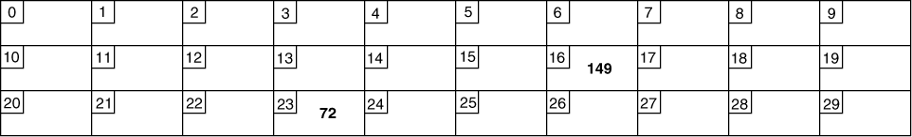
Main Memory
Also called Random Access Memory (RAM)
It is volatile, which means it is erased when the program terminates or the computer is turned off
Organized as follows:
bit: smallest piece of memory, has values 0 (off) or 1 (on)
byte: 8 consecutive bits. Each byte has a unique addresses.
In the above figure, the number 149 is stored in the byte with the address 16, and the number 72 is stored at address 23
The name of a variable is the address of that variable, and so far we’ve accessed data with a variable name
Now we learn how to access data by using the address of that data

Slide 4
9.1, 9.2
Pointers

Slide 5
Pointer = Address of a Variable
Each variable in a program is stored at a unique address in memory
The address is a large value usually shown as a hexadecimal number
Example:
int num = -99;
The address operator & is used to get the address of a variable:
cout << num; // prints: -99
cout << &num; // prints: 0x4a00
The address of a variable is called a pointer because it points toward the variable
Pointers are useful because they allow access to the data from any function in the program, and they are the only way to access dynamic variables (discussed later in the module)
num
0x4a00
-99
address of num = 0x4a00
num
-99
0x4a00

Slide 6
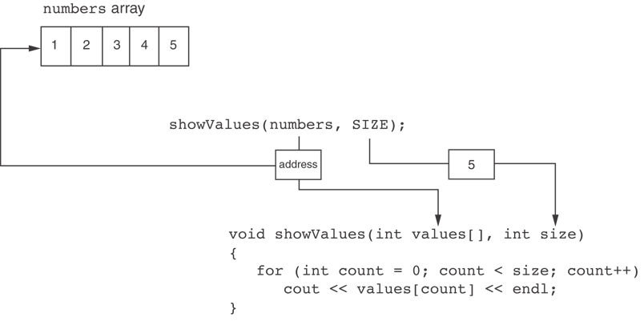
Pointers and Arrays
An array name is the address of the array or a pointer to the array
When we pass the array name to a function, the address of the array is actually sent to the function
C++ automatically stores the address of numbers in the values parameter.

Slide 7
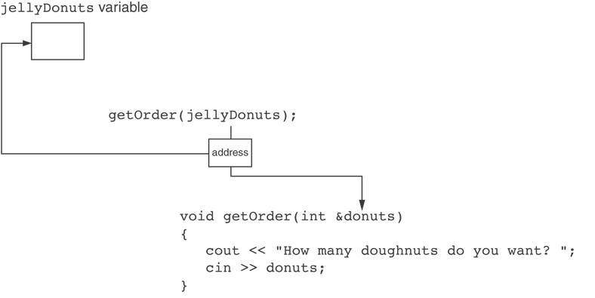
Pointers and References
A reference is also a type of pointer
When we pass a variable to a reference parameter in a function, the address of the variable is actually sent to the function
C++ automatically stores the address of jellyDonuts in the donuts parameter.

Slide 8
Pointer Variables
Because pointers are addresses, which are integers, they can be stored in a special type of variables called pointer variables
A pointer variable stores an address, just like an array name and a reference variable store an address
Define a pointer variable:
int * intPtr; // intPtr can hold the address of an int
Initialize a pointer variable:
int * intPtr = &num; // intPtr holds the address of num
Use a pointer variable to access data:
The indirection operator * dereferences a pointer, which means it allows you to access the item that the pointer points to cout << *intPtr << endl; // prints 6
num
intPtr
6
0x4a00
address of num: 0x4a00

Slide 9
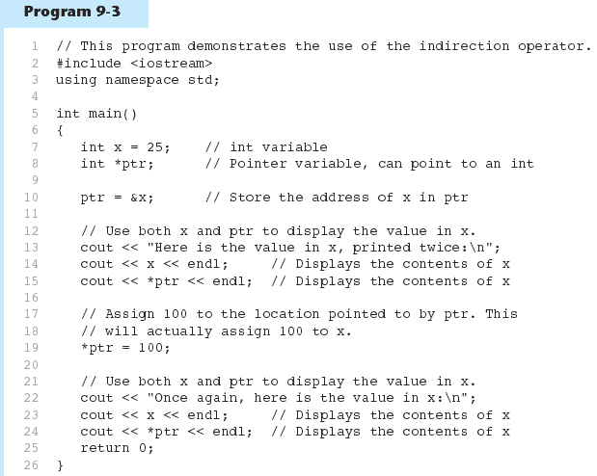
Example of Pointer Variables

Slide 10
9.3
The Relationship Between Arrays and Pointers

Slide 11
The Relationship Between Arrays and Pointers
The array name is the address of the first element of the array, or the pointer to the first element of the array
int vals[] = {4, 7, 11};
The array name can be used to access the data:
cout << vals; // displays address 0x4a00
cout << vals[0]; // displays 4
The array name can be used as a pointer to access the data:
cout << *vals; // displays 4
A pointer can be used as an array name:
int * valptr = vals; // valptr is the same as vals
cout << valptr[1]; // displays 7
cout << *(valptr+1); // displays 7
cout << *(valptr+2); // displays 11
vals = address 0x4a00
vals = address of 4
4 | 7 | 11

Slide 12
Array Access
Array elements can be accessed in 4 different ways:
Array access method | Example
array name and [] | vals[2] = 17; // vals is array of ints
pointer to array and [] | int * valptr = vals; valptr[2] = 17;
dereference of array name and index | *(vals + 2) = 17;
dereference of pointer to array and index | *(valptr + 2) = 17;
The [] operator dereferences the array name just like the * operator

Slide 13
9.4
Pointer Arithmetic

Slide 14
Pointer Arithmetic
Pointer variables contain integers, therefore some arithmetic operators work with pointer variables to access array data
++ moves the pointer to the next element in the array
-- moves the pointer to the previous element in the array
+= moves the pointer a certain number of elements to the right
-= moves the pointer a certain number of elements to the left
- pointer subtraction to find the difference (the number of elements) between 2 pointers
Example:
int vals[]={4,7,11,5,20,12,8};
int *valptr = vals; // valptr points to 4
valptr++; // valptr points to 7
valptr--; // valptr points to 4
valptr += 5; // valptr points to 12
valptr -= 2; // valptr points to 5
cout << valptr – vals; // prints 3

Slide 15
9.5
Initializing Pointers

Slide 16
Initializing Pointers
Pointers can be initialized at definition time:
int num;
double val[3];
int * numptr = &num; // define and initialize numptr
// numptr points to num, or stores the address of num
double * valptr = val; // define and initialize valtr
// valptr is also the same value as val, they both contain
// the address of val[0], or they both point to val[0]
Cannot mix data types when initializing a pointer to a variable:
double cost;
int * ptr = &cost; // Error
If a pointer is not initialized, it contains garbage data. And accessing an uninitialized pointer will result in a program crash

Slide 17
9.6
Comparing Pointers

Slide 18
Comparing Pointer Variables
Relational operators (<, >=, etc.) can be used to compare addresses that are stored in pointers
int vals[]={4,7,11,5,20,12,8};
int *valptr = vals;
valptr += 5;
if (valptr > vals)
{
cout << *valptr << “ comes after ”
<< *vals << “ in the array\n”;
}
Comparing addresses stored in pointer variables is not the same as comparing data pointed at by pointers:
if (valPtr == vals) // compares addresses
// is valPtr pointing to the same memory
// location as vals?
if (*valPtr == *vals) // compares data
// is data at valPtr the same as data at vals?

Slide 19
9.7
Pointers as Function Parameters

Slide 20
Pointers as Function Parameters
A pointer can be a parameter for a function
Pointers work like reference variables, they allow the function to change the data of the caller
However, a pointer requires more work than a reference variable:
Use * on parameter in function prototype and function header
void getNum(int * ptr);
Use * in function body to dereference the pointer
cin >> *ptr;
Use & when passing argument to the function
getNum(&num);

Slide 21
Using pointers vs. references
The following are 2 versions of the swap function. One version uses references and the other version uses pointers
Using references
Function call:
int num1 = 2, num2 = -3;
swap(num1, num2);
Function definition:
void swap(int &x, int &y)
{
int temp;
temp = x;
x = y;
y = temp;
}
Using pointers
Function call:
int num1 = 2, num2 = -3;
swap(&num1, &num2);
Function definition:
void swap(int *x, int *y)
{
int temp;
temp = *x;
*x = *y;
*y = temp;
}

Slide 22
Pointers to Constants
The address of a constant can be stored in a pointer called a pointer to constant, or pointer to const
A pointer to const is defined with the keyword const at the front:
const int * p; // p points to an int which is a constant
Example: const double payRates[6] = {18.55, 17.45, 12.85, 14.97, 10.35, 18.89};
payRates is an array of constant doubles, so a function can accept the array as a parameter rates as shown:
void printPayRates(const double *rates, int size) { for (int count = 0; count < size; count++) { cout << "Pay rate for employee " << (count + 1) << " is $" << *(rates + count) << endl; }
}
Because rates is a pointer to const, the function cannot change the pay rates in the array

Slide 23
Constant Pointers
A constant pointer, or const pointer, is a pointer that is initialized to point to a variable, and then it cannot change to point to anything else
Example int value = 22; int * const ptr = &value;
ptr is a constant pointer to the integer variable named value, which means ptr cannot be changed to point to anything else
but the variable can still change from 22 to something else
An array name is a constant pointer to the array. Once the array is defined with a particular name (or address), the name is set to const so that it cannot be changed during run time
Example
int arr[4] = {2, 3, 5, 7}; arr is a constant pointer to the array of 4 integers, it holds the address of this particular array and cannot be changed to point to some other array

Slide 24
Constant Pointers to a Constant
A constant pointer to a constant is a pointer that is initialized to point to a constant, and then it cannot change to point to anything else
Example: const int value = 22; const int * const ptr = &value;
ptr is a constant pointer to the integer constant named value, which means ptr cannot be changed to point to anything else
the integer constant value cannot change from 22

Slide 25
9.8
Dynamic Memory Allocation

Slide 26
Dynamic Memory Allocation
Dynamic memory allocation means that memory is allocated to store data while the program is running
This is in contrast to local variables, where memory is allocated before the program runs
Use the new operator to dynamically allocate memory:
double *dptr;
dptr = new double; // allocate memory for a double variable
new returns the address of the allocated memory
To dynamically allocate memory for an array: const int SIZE = 25; arrayPtr = new double[SIZE];
Then use [] or pointer arithmetic to access array:
for(i = 0; i < SIZE; i++)
arrayptr[i] = i * i;
or
for(i = 0; i < SIZE; i++)
*(arrayptr + i) = i * i;

Slide 27
Releasing Dynamically Allocated Memory
All dynamically allocated memory must be released when they are no longer needed, and before the program ends. If the allocated memory is not released, then there is a memory leak which will slowly use up all available memory of a system.
To release dynamically allocated variables, use delete varname;
Use [] when releasing dynamically allocated array:
delete [] arrayptr;
Only use delete with dynamically allocated memory, don’t use it with local variables
After releasing memory with delete, it’s good practice to set the pointer to 0
Example: delete ptr;
ptr = 0;
This prevents someone from accidentally using the pointer to access the area of memory that was released
If delete is accidentally called on the pointer again, it will not cause an error

Slide 28
9.9
Returning Pointers from Functions

Slide 29
Returning Pointers from Functions
A pointer can be returned from a function
The return data type is: data_type *
int * newNum(); // newNum returns the pointer to an int
A function should never return a pointer to a local variable in the function, because all local variables are released when execution returns from a function
A function should only return a pointer:
If the pointer was passed to the function as an input argument, or
If the pointer points to dynamically allocated memory

